Slide 1
Roadmap Update
Trupti Kulkarni (trupti.kulkarni@geant.org)
Antoine Delvaux (adelvaux@man.poznan.pl)
TNC16, Prague
13/06/2016

Slide 2
perfSONAR
The perfSONAR Collaboration
Roadmap
Strategy
Annual Survey Results
What’s coming in the next release
© 2016, http://www.perfsonar.net
Notes:
A lot of time - 18 months to be precise - has passed since the convergence of the 2 major editions of perfSONAR into one single product offered as part of a global collaboration. This showcase is about roadmap of perfSONAR, product strategy and features of upcoming releases.

Slide 3
The perfSONAR Collaboration
Open Source project lead by ESnet, GÉANT, Indiana University, and Internet2
Each organisation has committed 1.5 FTE effort to the project
Additional help from many in the community (OSG, RNP, SLAC and more …)
The perfSONAR roadmap is influenced by
requests on the project issue tracker
annual user surveys
meetings with VOs such as WLCG, OSG
discussions at various perfSONAR related workshops
Based on the above, every 6-12 months the perfSONAR Steering Group meets to prioritise features
Notes:
based on: impact to the community, level of effort required to implement and support, availability of someone with the right skill set for the task

Slide 4
perfSONAR Vision
Grow perfSONAR to be the ubiquitous, indispensible performance monitoring framework for R&E network customers that meets their needs in the long-term, supported in a self-sustaining way so as to enable friction-free science
Notes:
Today, there is no such thing as a simple network; all networks are complex, heterogeneous – in terms of both network technologies and geography. Project collaborations occur over these networks, and it is of utmost importance that the network perform its best. To help do this, pS as a monitoring and measurement testing infrastructure, provides the ability to pinpoint any problems when they occur, and helps mitigate them from future occurrences. This is the vision of pS.

Slide 5
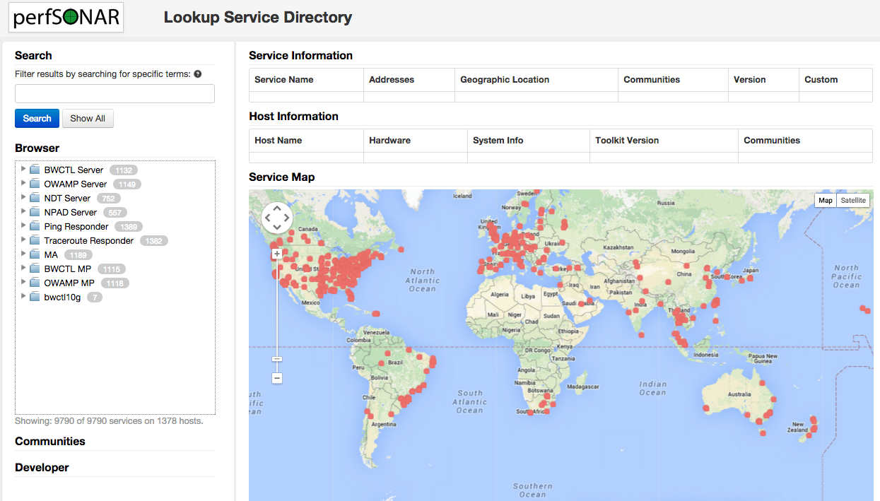
Who is running perfSONAR
~1600 publicly registered servers
http://stats.es.net/ServicesDirectory/

Slide 6
perfSONAR: Bundles for different use cases
Previous:
perfSONAR Toolkit: Included CentOS 6 and all perfSONAR components
New:
perfSONAR tools only
Support for both RHEL and Debian hosts
Centrally managed hosts
Central management
Testpoint
Notes:
Effort is made to support the bundles for both RHEL and Debian environments

Slide 7
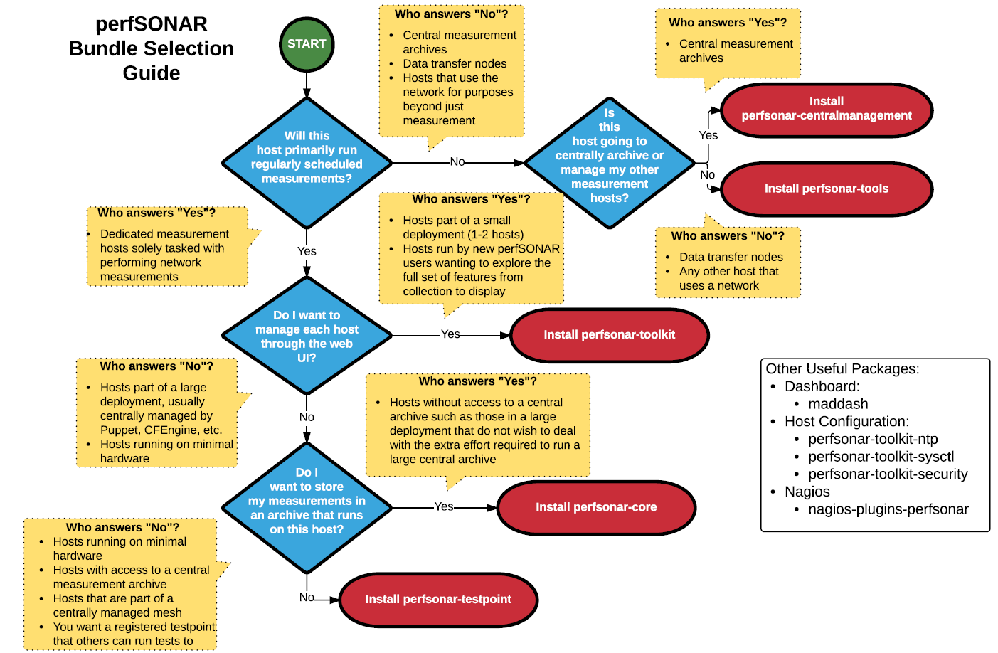

Slide 8
perfSONAR: What’s next in the roadmap

Slide 9
Roadmap Strategy
2 releases per year
1 major, 1 minor
Exploratory tasks in parallel during each release schedule
Ideas from user groups, results of annual survey, developers
Results and CBA-based analysis to decide if it makes it into the next version as a feature

Slide 10
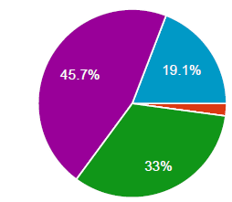
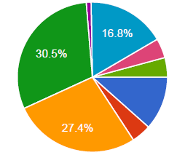
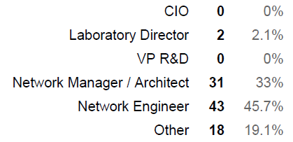
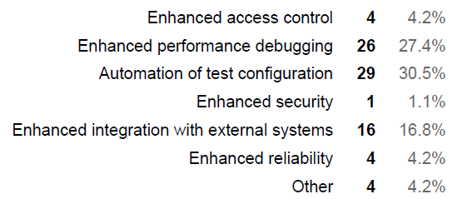
Annual Survey Results
Conducted in January 2016
Satisfaction
71% - satisfied/highly satisfied
26% neutral, 2% dissatisfied
Technical trends
Need for Debian 8 and CentOS 7 support
Enhanced performance debugging
Integration with other tools…

Slide 11
Upcoming Release: perfSONAR v4.0
Themes
Control
Better control over tests (authorisation, schedule management)
Scalability
Robustness to scale deployment per campus to 100 nodes
Expected to be released in late September/early October

Slide 12
perfSONAR v4.0 - Features
New and improved test scheduler: pScheduler
For fine-grained, better control (authorisation, schedule management)
Shared awareness of resource usage by other tests
Web interface for test meshes
Easier selection of endpoints, based on
geographic location
accessibility
custom searches
Support for alerting
June 10, 2016
Notes:
Default open model for testing. But as number of hosts grows, we need to be able to ctrl who is running the tests, how often, how do I find out which hosts can I run tests with, etc.
pScheduler – increased visibility & ctrl as to when will the tests be run, & by whom. Modules dependant on this will also be updated: mesh config, toolkit GUI, pSUI.
CentOS 7 pkg support for tools, testpoint, core and central mgmt. bundles. (start of CentOS transition)
All major features such as test scheduler, alerting, endpoint selection will come with a rich API support for easy adaption and integration with tools outside of pS.

Slide 13
perfSONAR v4.0 - Features
Increased support on Debian 8, CentOS 7
Linux namespaces support
Oft-requested feature for ability to carry out monitoring and measurements in VPNs
Challenges:
Same physical interface in-use at same time by different VPNs, same subnet in more than one namespace, archiving test results…
To address the above
Widen the scope by extracting measurement results of VPNs (and circuits too?)
Monitoring and measuring service parameters
Notes:
SQM provides monitoring service for GEANT MDVPN service. L2 and L3 VPNs.

Slide 14
Deployment Options
Recommended to deploy perfSONAR on dedicated, physical hardware
For accurate measurement results
However…
Requirement to be able to use perfSONAR in other deployment scenarios as well
Such as:
Organisation with limited budget, or small network
Numerous deployments
Mobile solution where measurement areas are fluid within sites in the network
Temporary setup

