Slide 1
perfSONAR
on Low Cost Hardware
Antoine Delvaux (adelvaux@man.poznan.pl)
Szymon Trocha (szymon.trocha@man.poznan.pl)
Trupti Kulkarni (GEANT), Ivan Garnizov (DFN/Univ Erlangen)
TNC16, Prague
13/06/2016

Slide 2
Agenda
Small Nodes? Yes!
Examples, limitations and usefulness
Small Nodes in GÉANT
Hardware
Setup
Questions & Answers

Slide 3
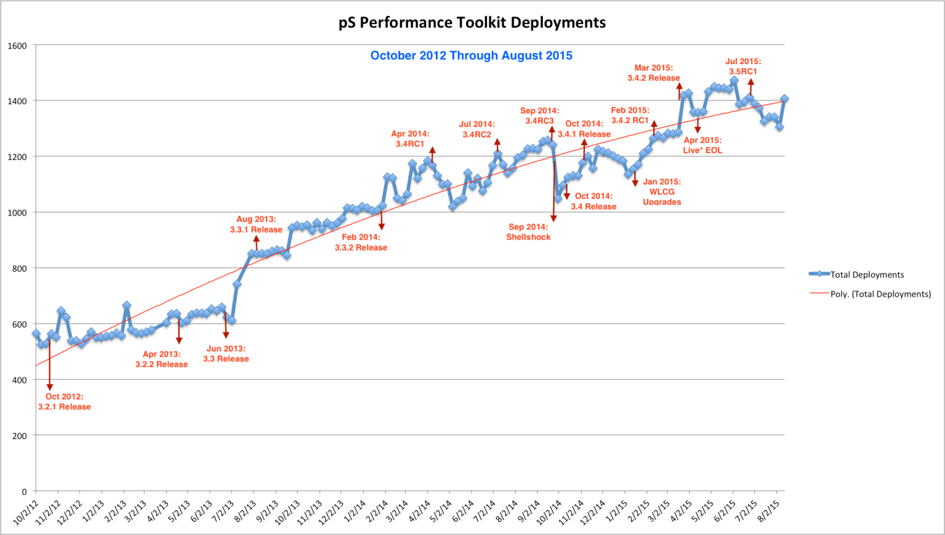
Footprint increase

Slide 4
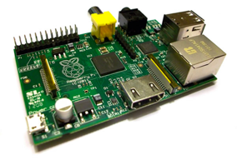
Small Nodes?
Many different experimentations
cheap deployments and small form factor
more deployments, more useful perfSONAR is
Early trials
Very cheap HW: Cubox, Beaglebone, Raspberry Pi, …
ARM based challenge (no CentOS support)
Survey
33%

Slide 5
Small Nodes!
Survey results: Inexpensive but with known capabilities:
1 Gbps with enough RAM and disk space
perfSONAR project official support from 3.5 onwards
Debian support (easier for ARM devices)
Improved central management
Cost target: € 200
Many different hardware choices

Slide 6
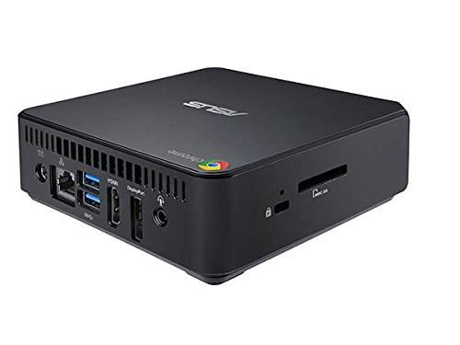
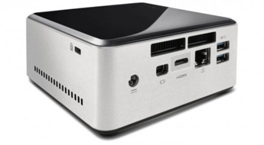
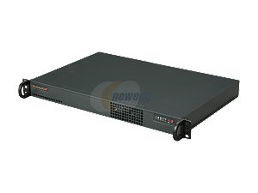
Examples
Intel NUC kit
ASUS Chromeux
Liva I/X/X2
Gigabyte BRIX
Zotac BOX
Servers Direct/Supermicro

Slide 7
Limitations: what to look at
CPU power, RAM (8 GB preferred)
Multiple NIC?
Disk space (or use central server)
Form factor (rack mount, durability, …)
Newer, better, always coming soon!
You get what you pay for… tradeoffs always.

Slide 8
So this replaces large server?
No, not really.
More memory, higher speed, warranties, stability
Useful for custom and numerous deployments or as starters’ boxes
IoT?
Notes:
Still need to have larger boxes with more memory, higher speed, warranties, stability.
Useful for custom and numerous deployments or as starters’ boxes.

Slide 9
Small Node in GÉANT
Enable you to have first hand experience with perfSONAR
Easy and useful setup
6 months project with
provided hardware
central server and support run by GÉANT SA2T3
Launch: TNC2016
Notes:
GÉANT run central server
GÉANT perfSONAR experts to provide support

Slide 10
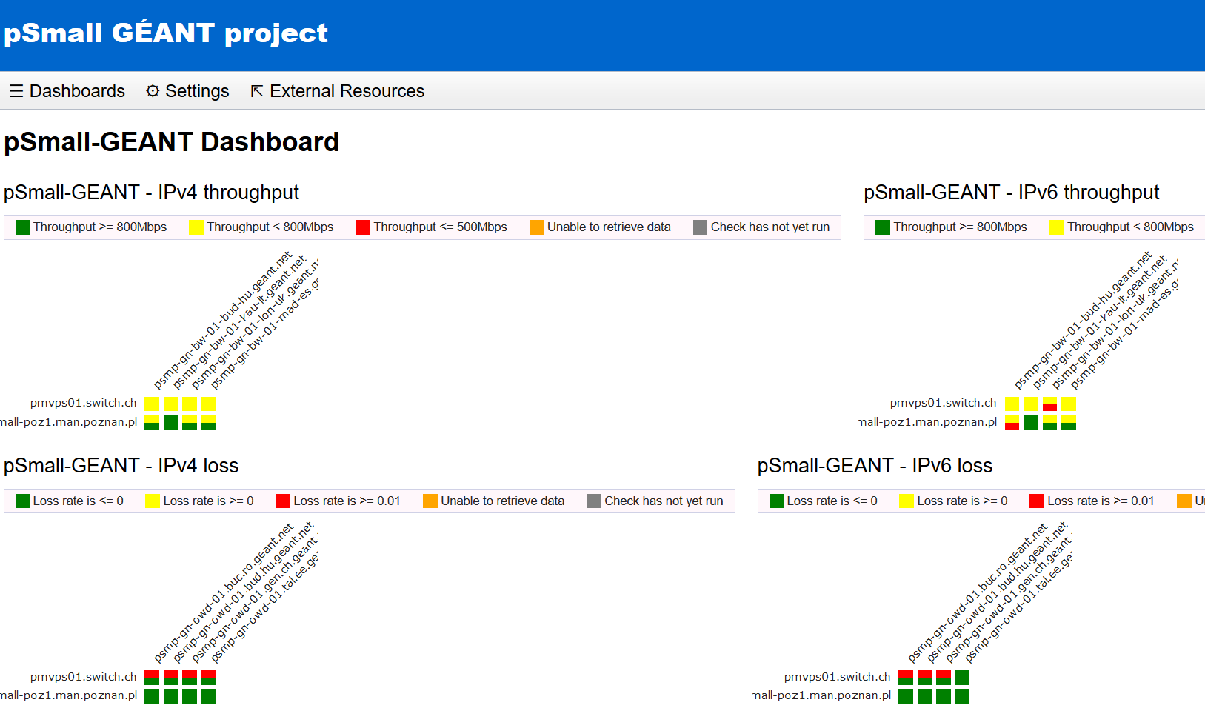
Measurements
to 8 GÉANT MPs
geographically spread
throughput (4)
latency/loss (4)
IPv4 and IPv6
Optionally between small nodes
Central server: GÉANT
Add your own measurements, experiment yourself

Slide 11
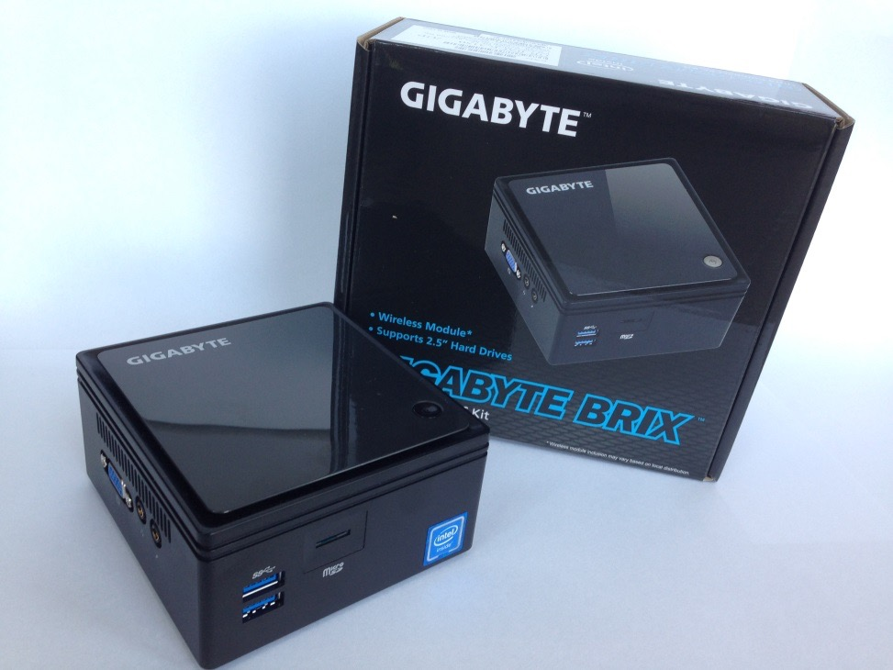
Hardware chosen
GIGABYTE BRIX
GB-BACE-3150
1 x SO DIMM DDR3L 1.35 — 8GB RAM
1Gb/s RJ45 LAN Realtek
WiFi + BT
VGA, HDMI
4 x USB 3.0
Micro SD
External power supply
Durable chassis
6 x 11 x 11 cm

Slide 12
Intel Celeron N3150 1.6GHz
4 cores
120GB
Patriot SSD
/ 20 GB
/var/lib 86 GB
Swap 8 GB
8GB RAM Kingston
What’s inside? Current configuration

Slide 13
Other initial settings
pre-install of the perfSONAR toolkit 3.5.1
CentOS 6
Administrative accounts: psudouser, pswebadmin, geantadmin
root remote login disabled
Auto-updates enabled by default
Tagged with communities : GEANT, pSmall-GEANT
Initial networking with DHCP
Monitoring with SNMP (deamon runnig)
1 master node, rest cloned

Slide 14
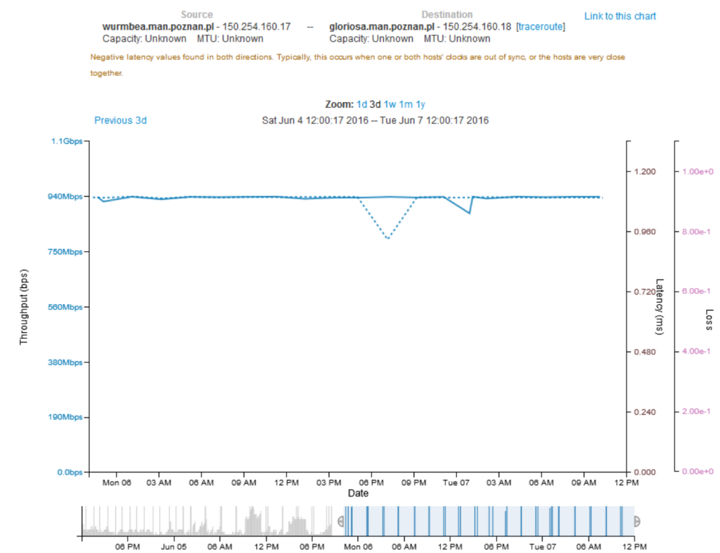
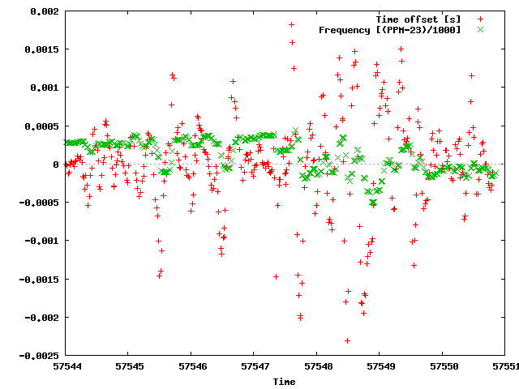
Initial performance
Selftest efficiency
NTP observations

Slide 15
Known limitations
Single NIC
Competing BW + OWD
Limited queuing
Resources
CPU limits
HDD storage
Using the same interface
NTP
No heating problems observed
Some mitigations made but need more feedback from you

Slide 16
Setting up your pSmall node
Power on and access locally or via SSH
Connect to the network and configure IPv4 and IPv6
Launch Web interface and configure basic settings to describe the node
Modify NTP
Inform GÉANT perfSONAR support team
perfsonar-smallnodes@lists.geant.org

Slide 17
Recommendations and usage
Deploy it in the core of your network
Assign fixed IPv4 and IPv6 address and don’t change it later
Define stable DNS name
Add your own measurements through the webUI
other European NREN and Organisations
the R & E networks worldwide
other Small Nodes
Free to experiment with the node
Use ServicesDirectory

Slide 18
How to get support?
From the Small Nodes project during 6 months
project mailing list
central server operations
help in running the small node
From other perfSONAR resources
Users mailing list (perfsonar-user@internet2.edu)
Global website (http://www.perfsonar.net/)

Slide 19
What’s next?
Visit dashboard to check performance
http://perfsonar-smallnodes.geant.org/maddash-webui/
Participate to the mailing list
perfsonar-smallnodes@lists.geant.org
https://lists.geant.org/sympa/info/perfsonar-smallnodes
Report at STF / High Performance Networking workshop in July in Vienna
https://eventr.geant.org/events/2428
Evaluation in 4 to 6 months

Slide 20
Requirements to participate
Belonging to the R & E community
Being part of a networking team, service or research group
Identified responsible person to sign agreement
Priority given to GÉANT Service Area organisations and/or small organisations
Note: Node remains property of GÉANT

Slide 21
TNC2016: perfSONAR on Low Cost HardWare
TNC 2016
13rd of June 2016
Antoine Delvaux — PSNC/GÉANT adelvaux@man.poznan.pl
Szymon Trocha — PSNC/GÉANT szymon.trocha@man.poznan.pl

